Slide 1



GROUP PROJECT
CANTEEN APP SYSTEM
Architecture Type: Service-Oriented Architecture(SOA)
Group No. 04
Team Members:
  Kaustav Raj Chakravorty(2621516)
  Syed Mohammad Umar(2621532)
  Hrishiraj Gogoi(2621513)
  Akash Kumar Yadav(2621505)

Slide 2
PROBLEM STATEMENT
The existing manual or semi-digital canteen ordering faces several challenges:
  Long queues and increased waiting time during peak hours.
  Difficulty checking food availability before reaching the counter.
  Manual order-processing errors.
  Difficulty handling multiple simultaneous orders.
  Poor order-status visibility.
  Inefficient pickup-time and inventory management.
Need: A centralized digital solution to streamline food ordering, inventory, order processing and pickup.

Slide 3
PROPOSED SOLUTION
A centralized Canteen Pre-order System designed for convenient campus food ordering and scheduled pickup.
key features:
  Browse menu and check food availability.
  Add items to cart and select quantities.
  Make or simulate payments.
  Track orders using a unique Order ID.
  Receive order-status notifications.
  Dedicated interfaces for customers, staff and administrators.
Architecture: Service-oriented Architecture (SOA)with independent services communicating through REST APIs

Slide 4
REQUIREMENT ANALYSIS
Functional requirements
  Authentication and user management.
  Menu and Inventory Management.
  Cart and pre-order management.
  Payment and order processing.
  Pickup Verification and Cancellation.
  Notifications.
Non-Functional Requirements
  Performance and Reliability.
  Security and data integrity.
  Usuability and scalability.
  Maintainability and Interoperability.
  Privacy, Backup and Recovery.
  Constraints:Limited Development time, initial user capacity.

Slide 5
Technology Stack
Layer | Technology | Purpose
Frontend | React Native, Javascript, CSS | User Interface
Backend | Python, FastAPI | Server-side logic and APIs
Database | PostgreSQL | Store application data
ORM | SQLAlchemy | Database interaction
Authentication | JWT | User interaction

Slide 6
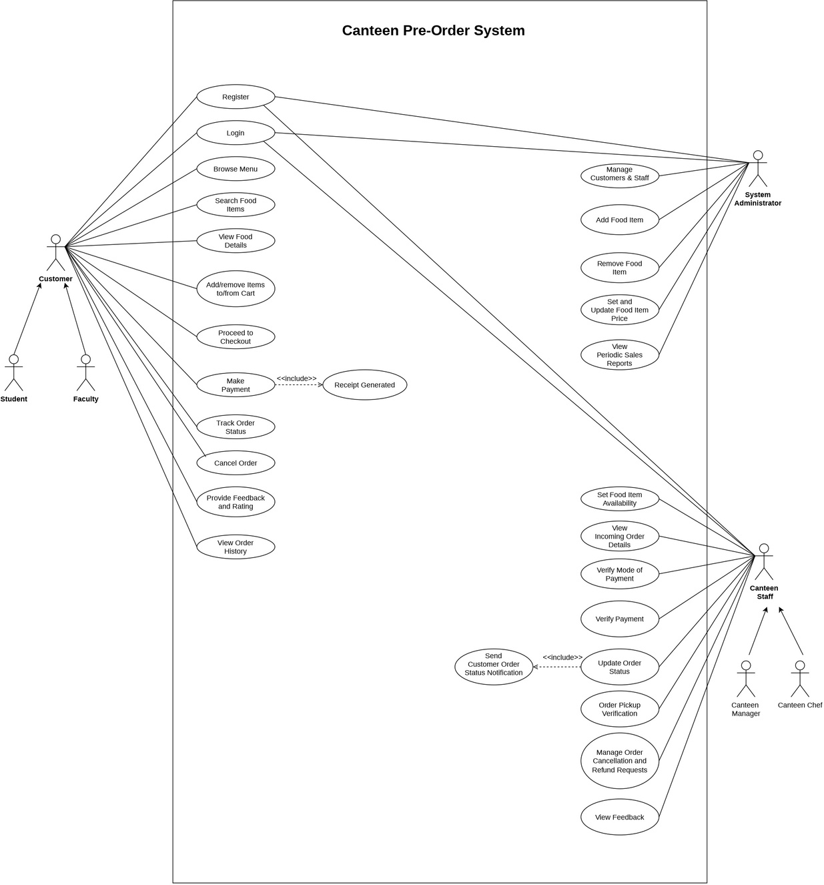
DESIGN

Slide 7
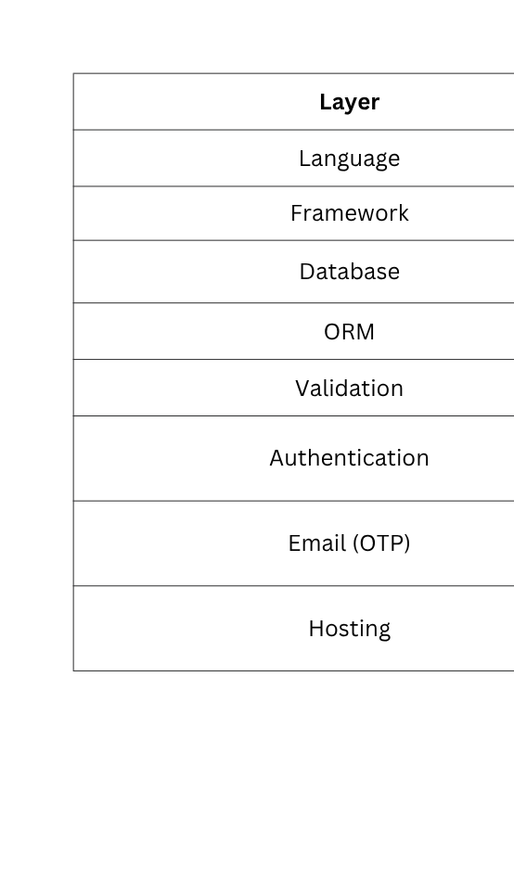
IMPLEMENTATION: BACKEND - Technology Stack

Slide 8
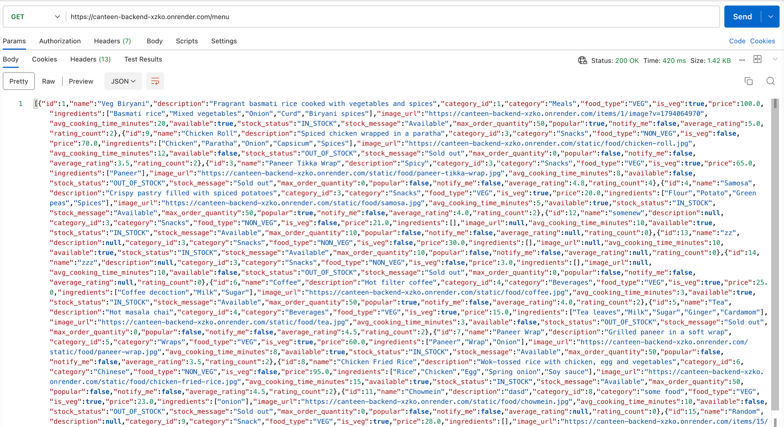
IMPLEMENTATION: BACKEND - API Endpoint (Customers)
GET https://canteen-backend-xzko.onrender.com/menu - For displaying the Menu (in Stock) for ordering

Slide 9
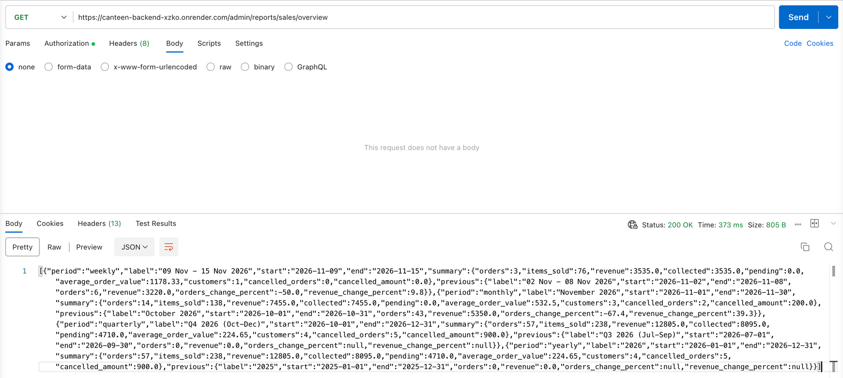
IMPLEMENTATION: BACKEND - API Endpoint (System Admin)
https://canteen-backend-xzko.onrender.com/admin/reports/sales/overview - For monitoring Sales Report Analytics Dashboard

Slide 10
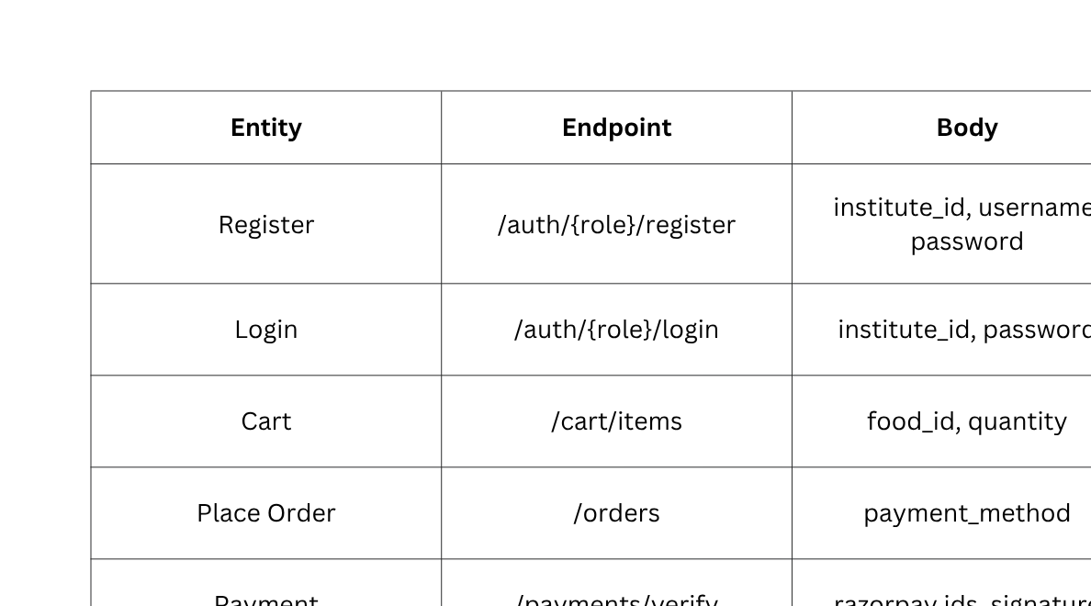
IMPLEMENTATION: BACKEND - All API Endpoints

Slide 11
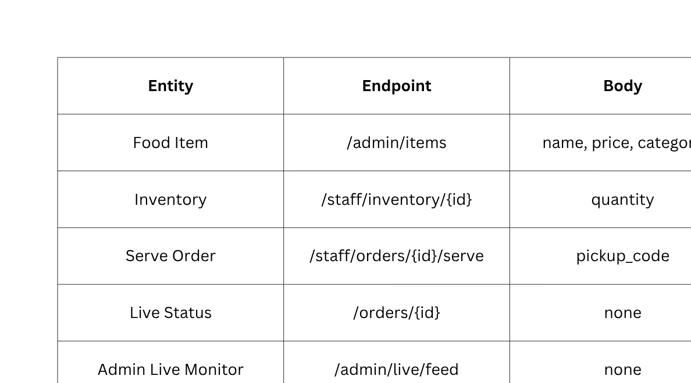
IMPLEMENTATION: BACKEND - All API Endpoints (Cont.)

Slide 12
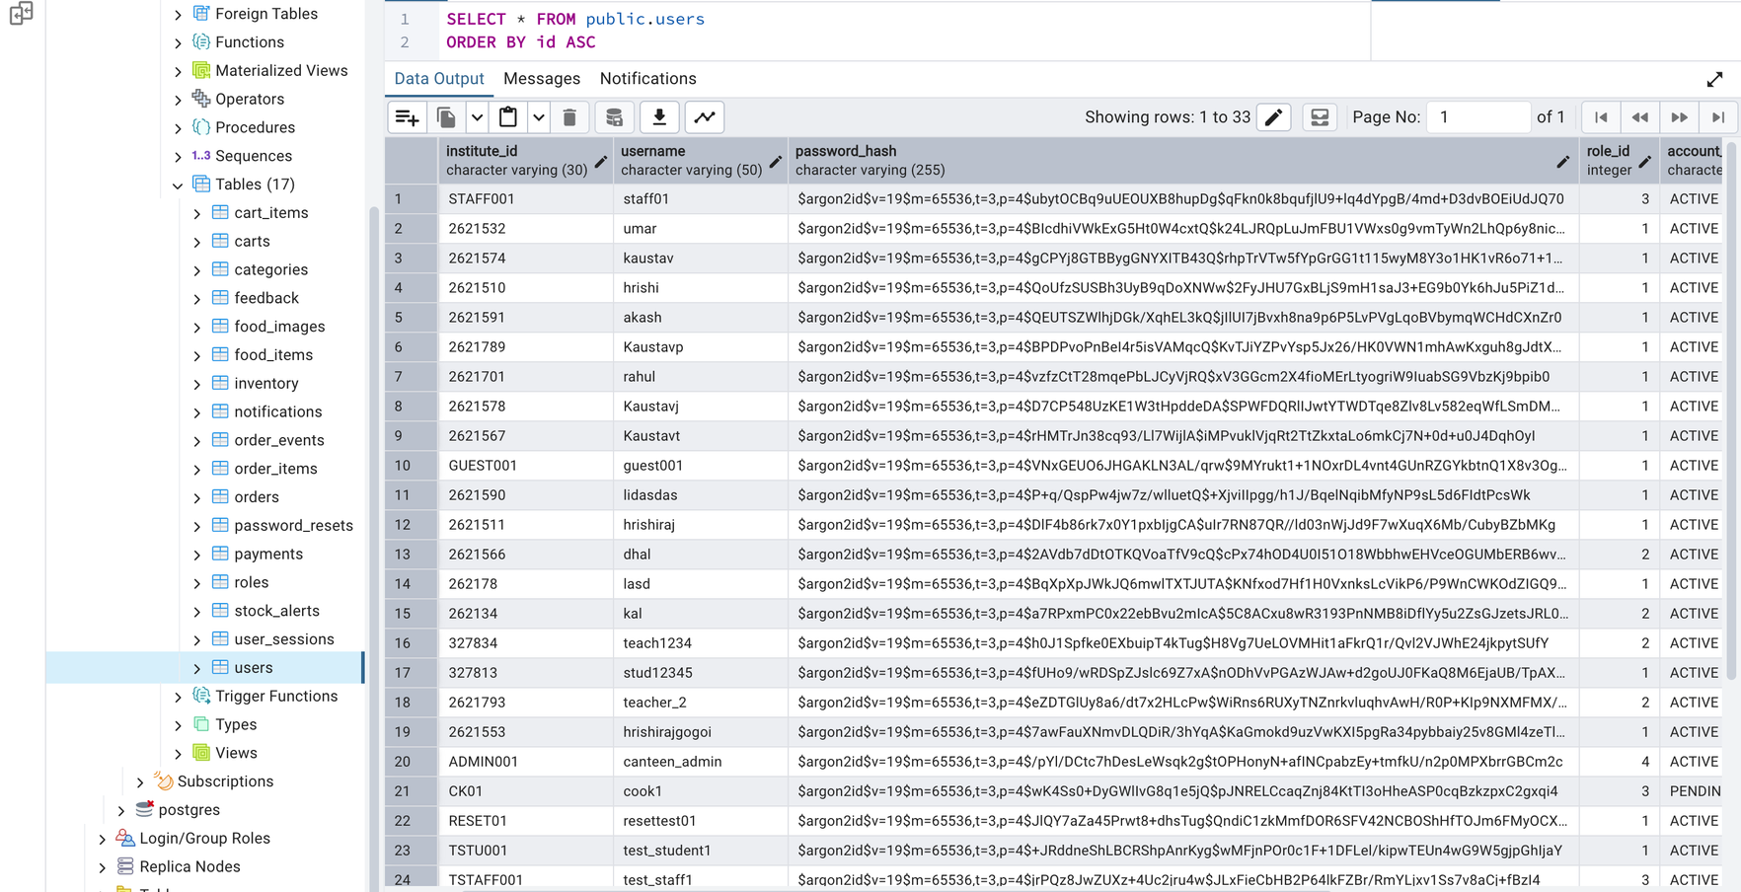
IMPLEMENTATION: BACKEND - Database (PostgresSQL)
Users/Customers Table

Slide 13
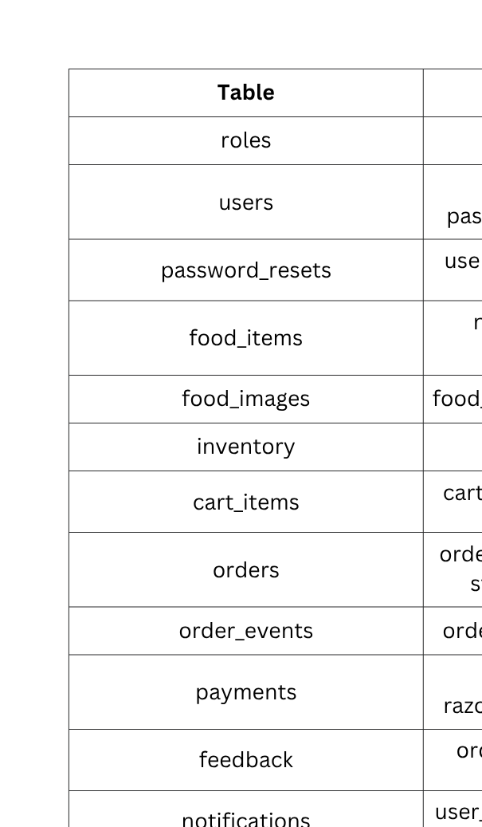
IMPLEMENTATION: BACKEND - All Tables in Database

Slide 14
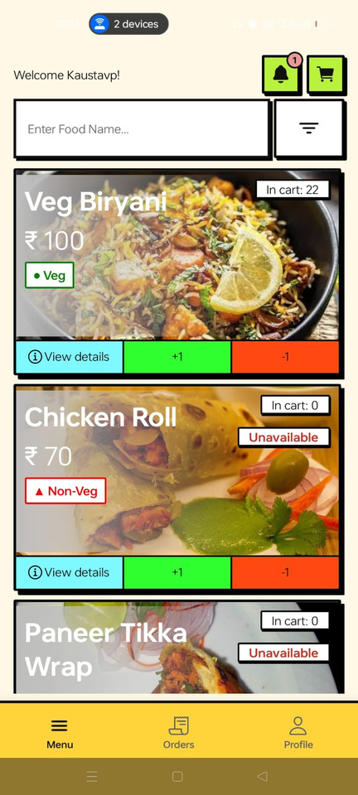
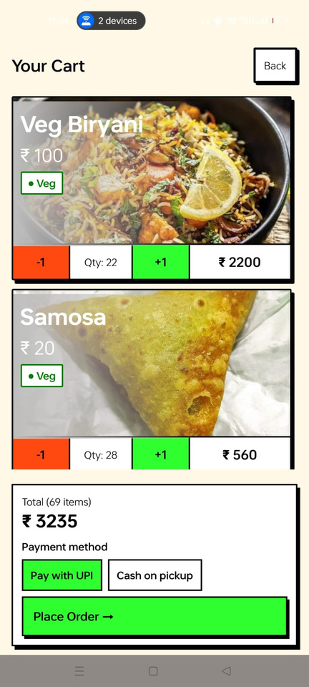
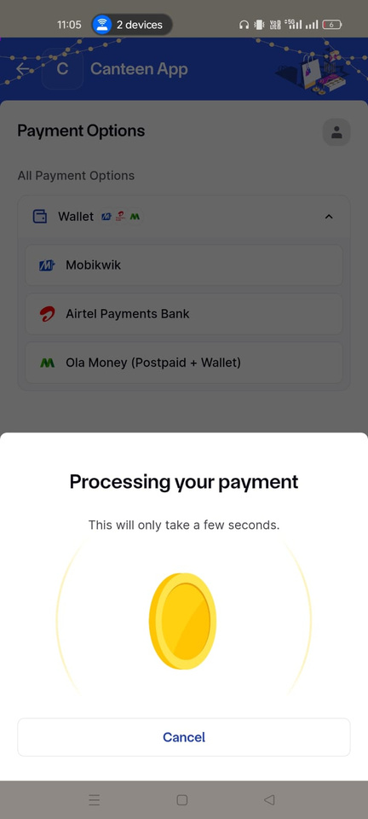
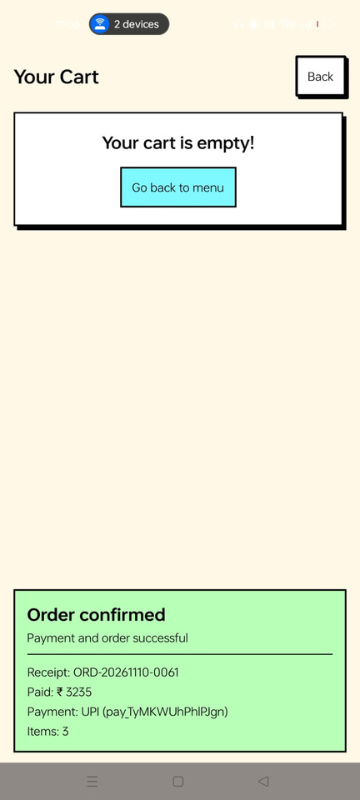
IMPLEMENTATION: Frontend
A generic success flow:
[CUSTOMER]
Browse Menu and add Items to Cart
[CUSTOMER]
Cart
[CUSTOMER]
Payments
[CUSTOMER]
On Order Placed

Slide 15
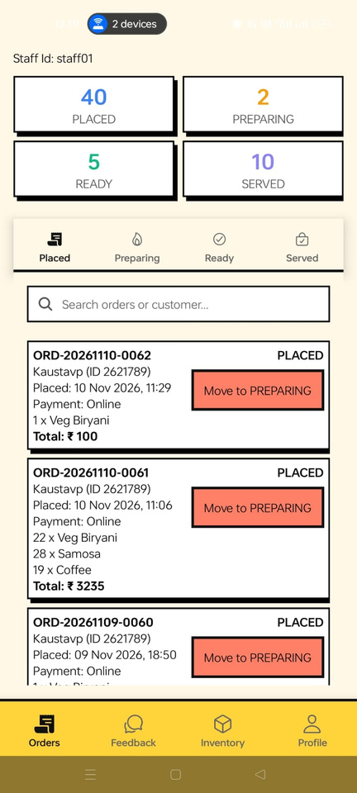
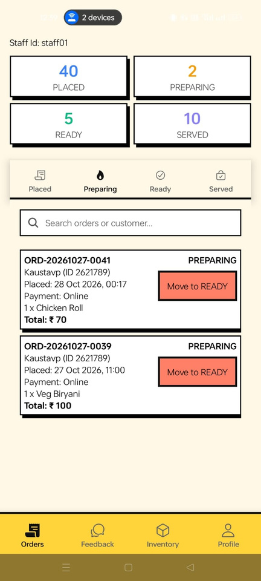
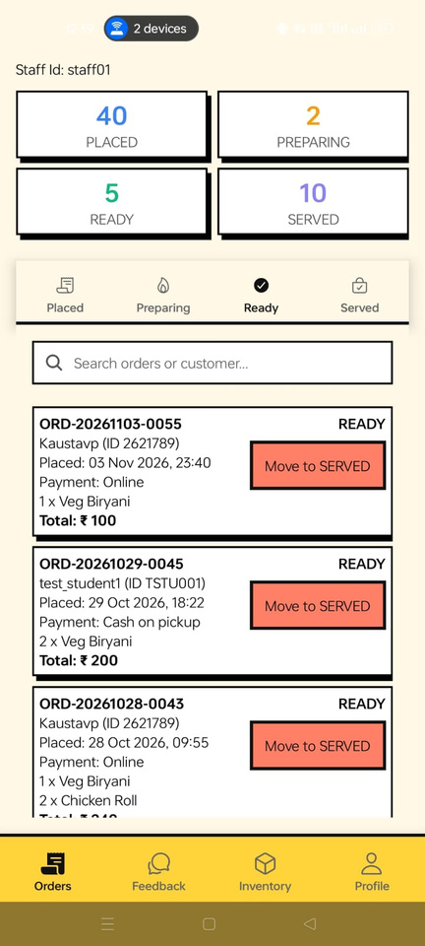
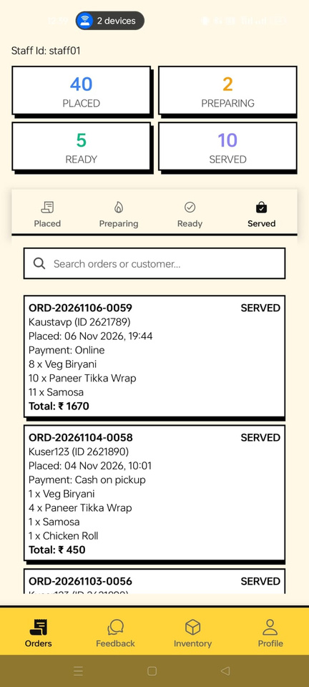
IMPLEMENTATION: Frontend
A generic success flow:
[STAFF]
Placed
[STAFF]
Preparing
[STAFF]
Ready
[STAFF]
Served
(After verification)

Slide 16
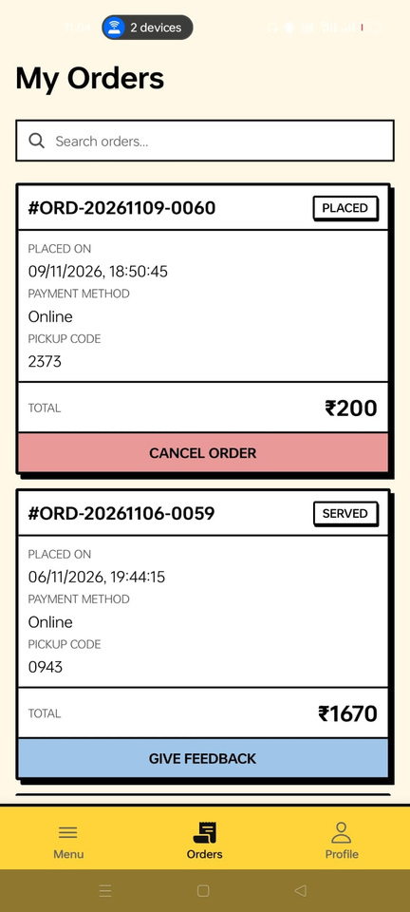
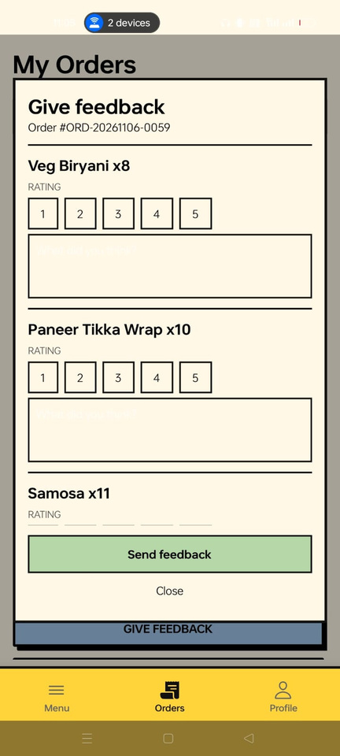
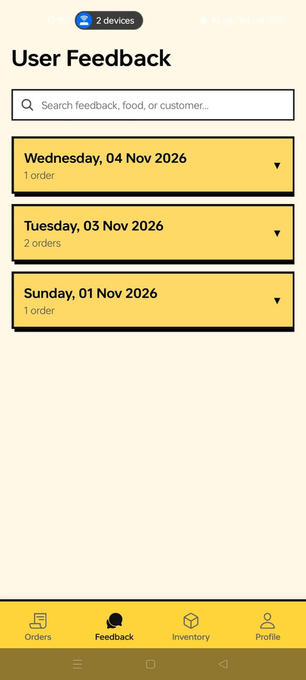
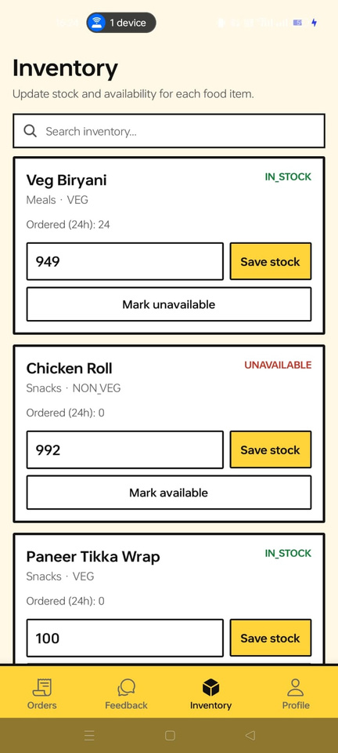
IMPLEMENTATION: Frontend
A generic success flow:
[CUSTOMER]
Orders
[CUSTOMER]
Provide Feedback
[STAFF]
Review Feedback
[STAFF]
Update Item Availability

Slide 17
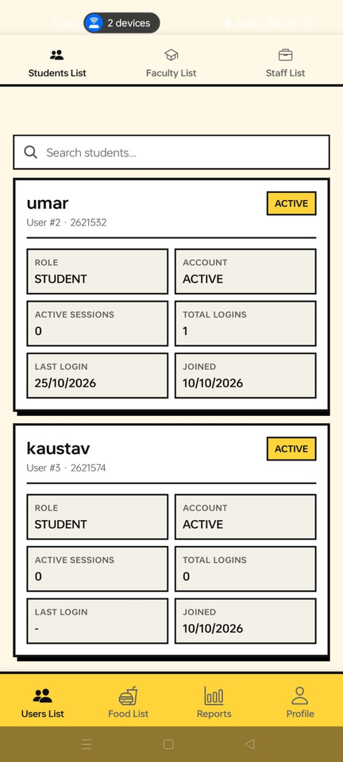
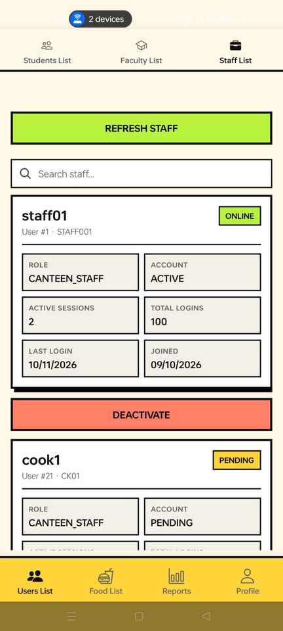
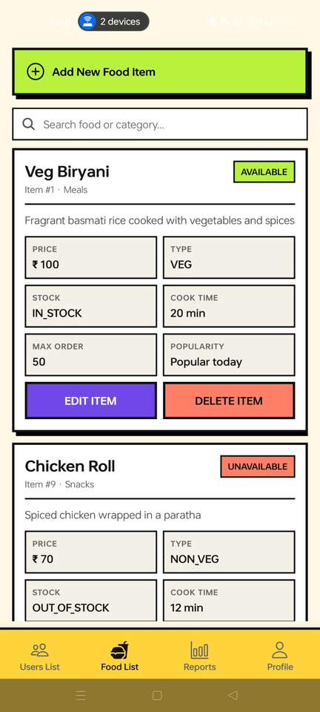
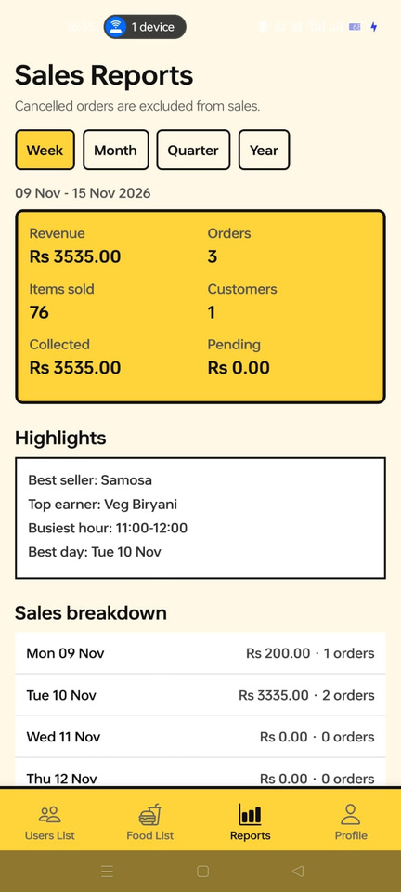
IMPLEMENTATION: Frontend
[ADMIN]
Customer List
[ADMIN]
Staff List
[ADMIN]
Food Items list
[ADMIN]
Sales Report

Slide 18
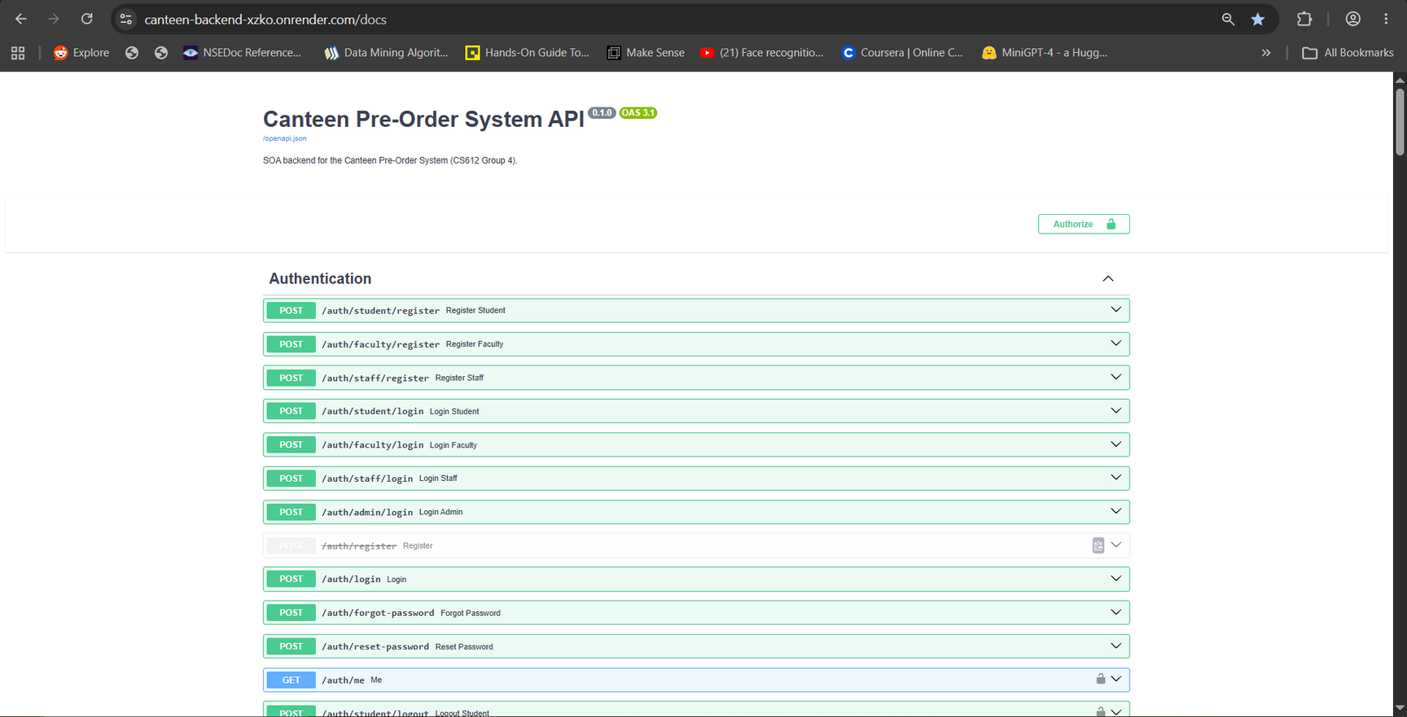
DEPLOYMENT
Backend
The backend API is deployed on Render, the base for URL which is:
https://canteen-backend-xzko.onrender.com/

Slide 19
DEPLOYMENT
Frontend
For the frontend, instead of a traditional hosted website, we built a native mobile application and so the users interact with the app via a compiled .apk package, which is configured to send requests directly to our live Render backend endpoints.

Slide 20
CONCLUSION
  The project follows a Service-Oriented Architecture in which nine independent services communicate through well-defined REST APIs.
  We developed a fully functional Canteen Pre-Order System that serves four user roles: Students, Faculty, Canteen Staff and the Administrator.
  The system reduces queues and waiting time by allowing users to place orders in advance and collect them with a unique pickup code.
  Customers can browse the menu, add items to the cart, make payment, track their order status in real time and give feedback on their food.
  Canteen staff can process orders through each stage of preparation, update food stock and verify every pickup before the food is handed over.
  The administrator can manage the menu and staff accounts, monitor system activity live and analyse performance through weekly, monthly, quarterly and yearly sales reports.
  Role-based access control, secure password storage and real-time stock checks keep the system secure and prevent items from being oversold.

